Slide 1
NUCLEAR SAFETY
Ronja Kivi, Helmi Helander, Vilma Komulainen

Slide 2
.
Taking care of the safety of employees, people and the environment.

Slide 3
How is nuclear safety being put into effect?
Isolating nuclear waste deep in the ground, so the radiation can´t affect people.
Even if one barrier fails, there is more to make sure that the radiation stays in the ground.
All the employees must wear all the necessary safety equipments.

Slide 4
Protection against terrorist attacks
Nuclear power plants are considered to be targets for terrorist or criminal attacks.
Such an attack could have catastrophic consequences.
There is special protection against air accidents and the power plants are designed against the impact of combat aircraft at a speed of about 800 km / h.

Slide 5
Why do we need nuclear safety?
The radiation is very dangerous for every living creatures.
Large amounts of radiation can cause for example cancer, mutations and the radiation can even be deadly.
By taking care of the safety, we can prevent accidents and other harms.
In order to use nuclear power, we need nuclear safety!

Slide 6
Nuclear safety in EU
The safety of nuclear energy production in the EU is the primary responsibility of power plant operators supervised by independent national regulators.
An EU-wide approach to nuclear safety is important because a nuclear accident could have negative consequences for countries across Europe and beyond.

Slide 7
Nuclear safety rules in EU
EU amended the latest Nuclear Safety Directive in 2014.
Directive requires EU countries to give the highest priority to nuclear safety. EU countries must take care of nuclear safety at all stages of the lifecycle of a nuclear power plant.
Directive includes:
Safety assessments before the construction of a new nuclear power plant.
Ensuring significant safety enhancements for old reactors
Requires a safety re-evaluation for all nuclear power plants to be conducted at least once every 10 years

Slide 8
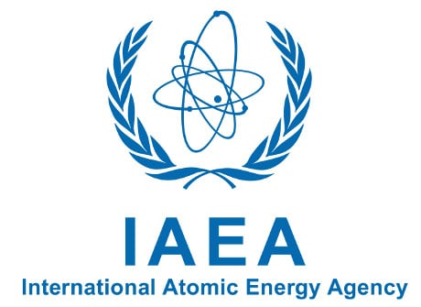
IAEA (International Atomic Energy Agency)
The IAEA was created in 1957 in response to fears and expectations of nuclear technology
The IAEA helps countries to upgrade their nuclear safety and to prepare for and respond to emergencies.
They work for protecting people and the environment from harmful radiation.

Slide 9
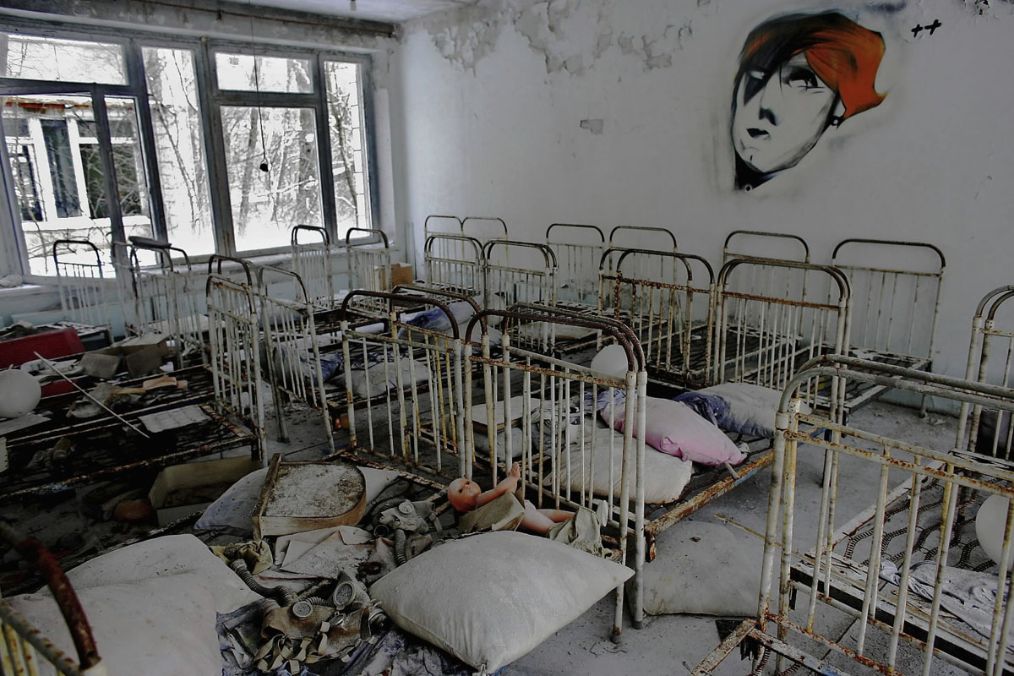
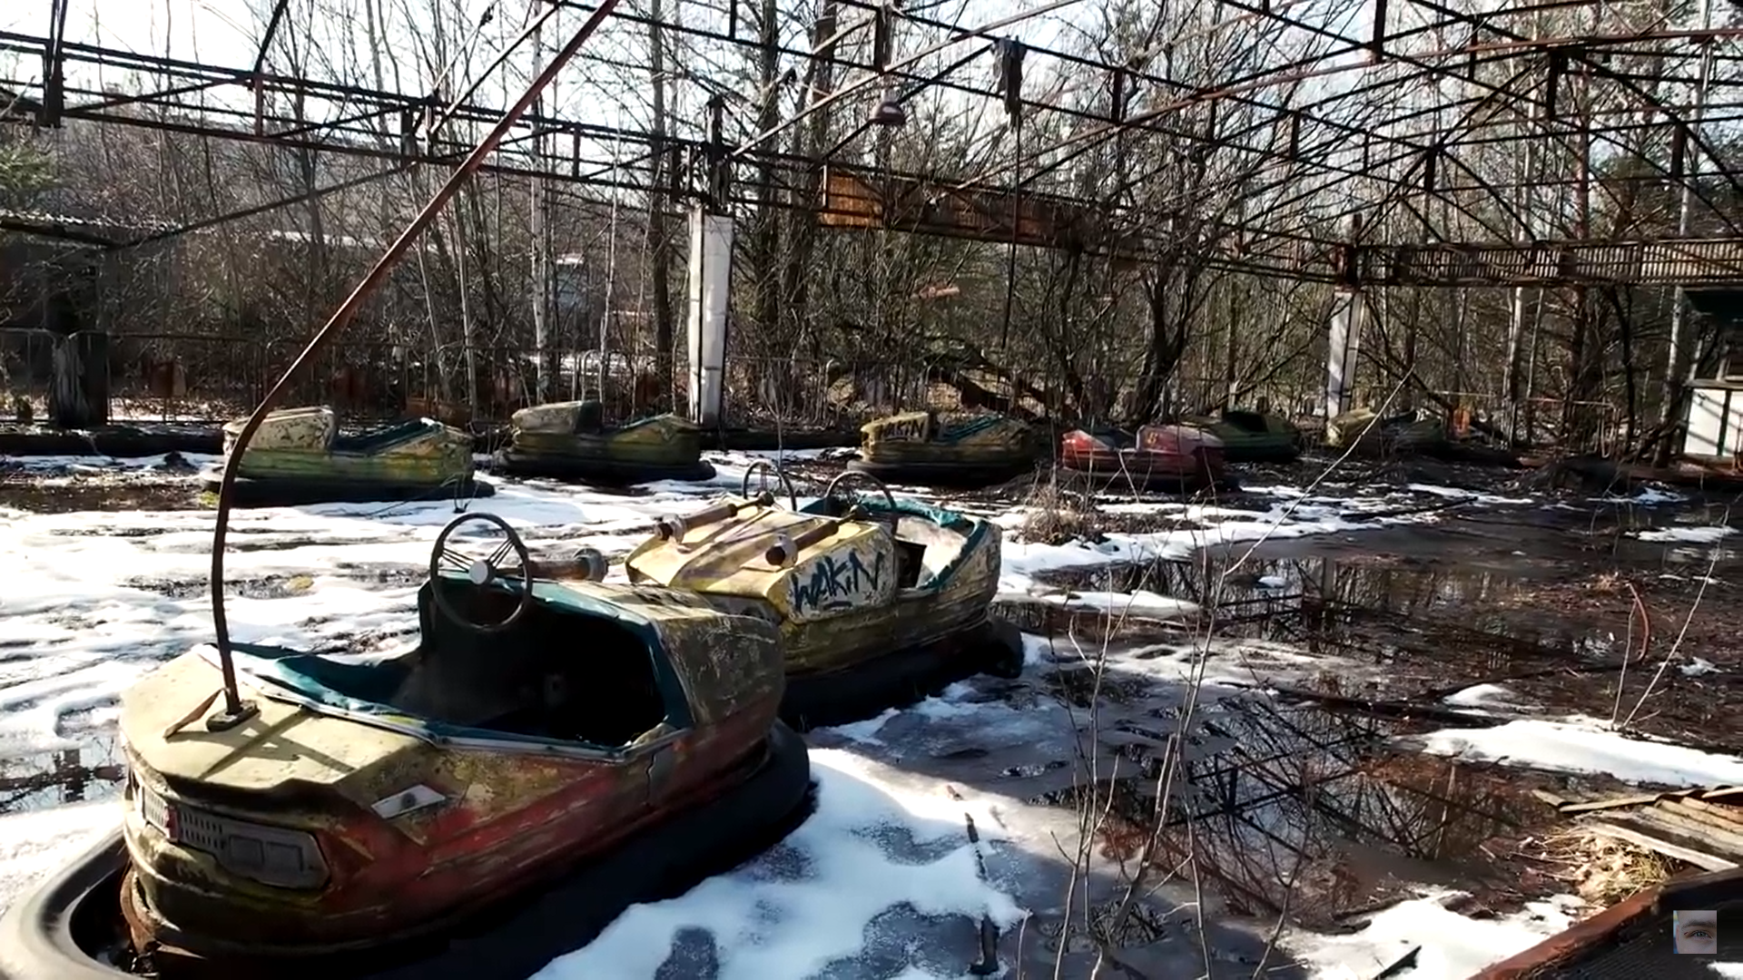
When the safety has failed: Chernobyl 1986
One of the biggest Nuclear Power accidents in history.
Fourth reactor exploded causing the death for over 40 people.
Careless construction, almost no safety measures at all.

Slide 10
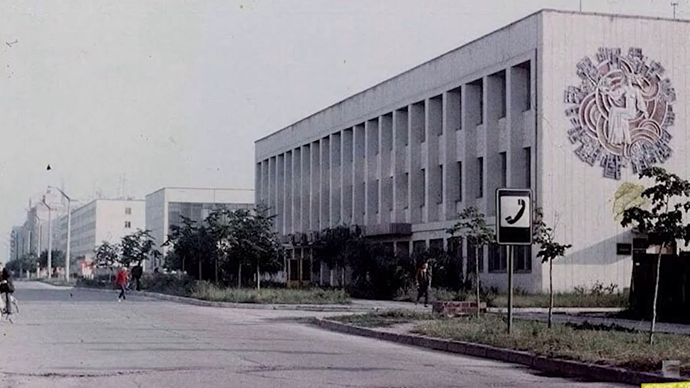
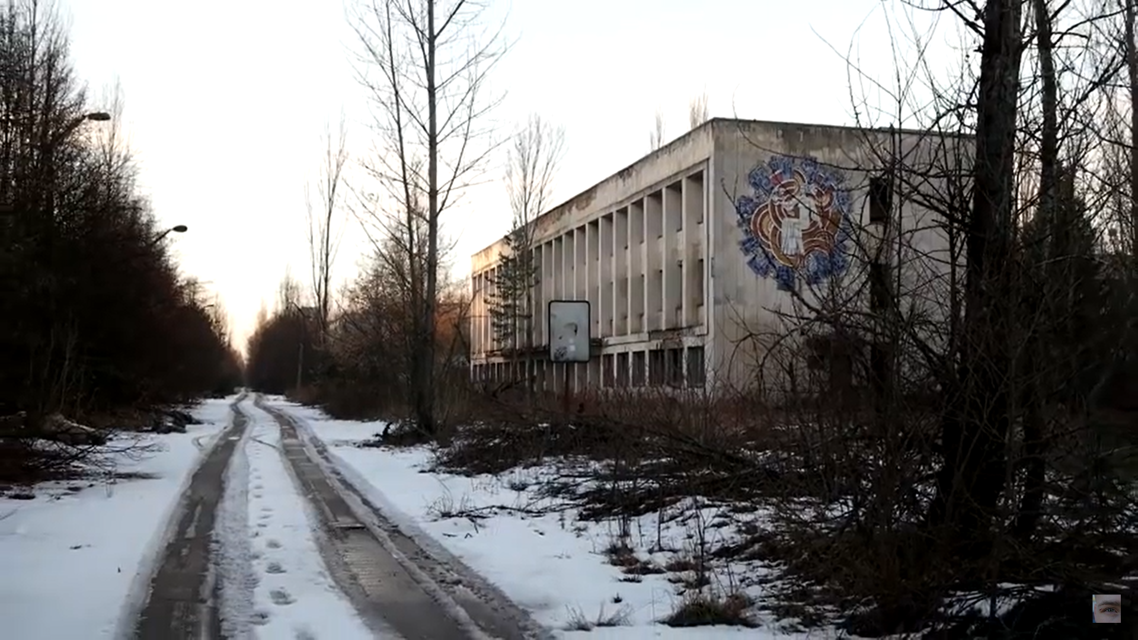
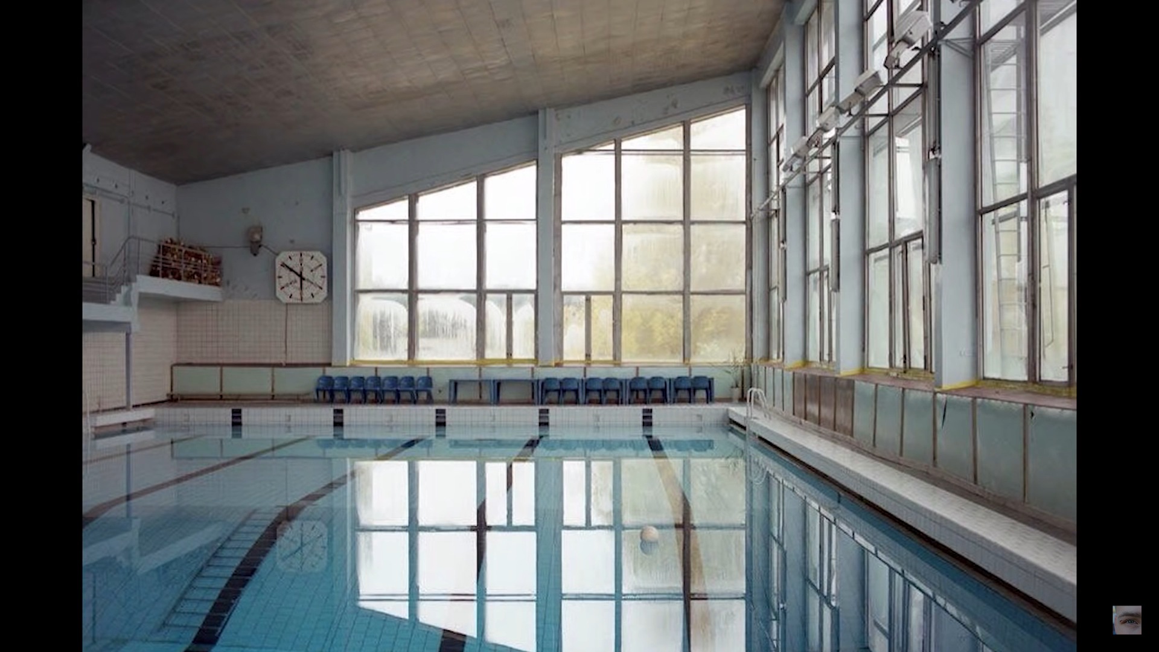
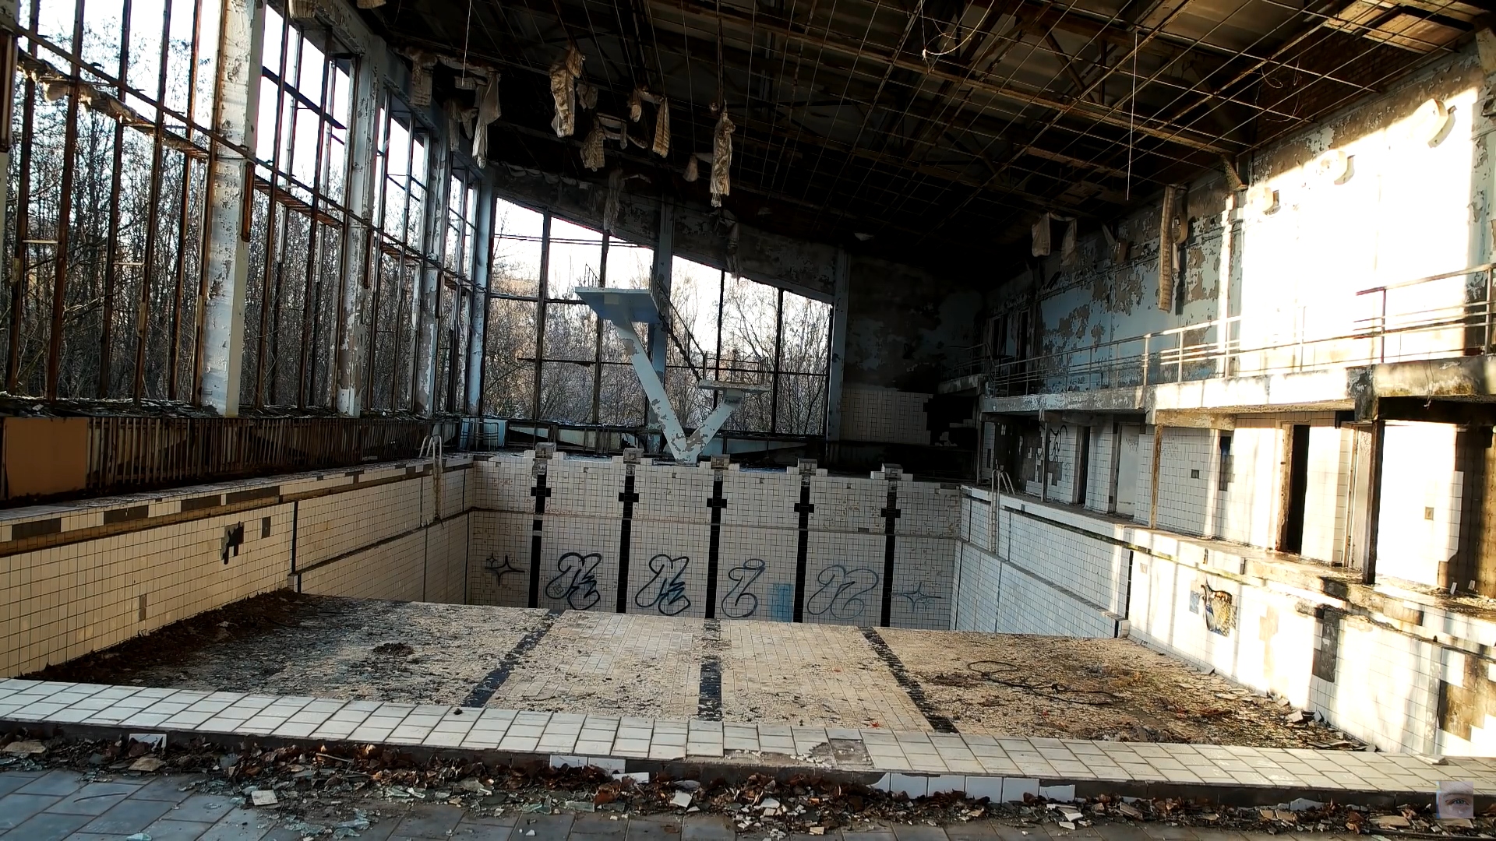
Chernobyl: before and after

